Slide 1

Федеральное Агентство Научных Организаций
ФЕДЕРАЛЬНОЕ ГОСУДАРСТВЕННОЕ БЮДЖЕТНОЕ УЧРЕЖДЕНИЕ НАУКИ
ИНСТИТУТ ЯДЕРНОЙ ФИЗИКИ ИМ. Г.И.БУДКЕРА
СИБИРСКОГО ОТДЕЛЕНИЯ РОССИЙСКОЙ АКАДЕМИИ НАУК
Измерение ионизационных выходов ядер отдачи в жидком аргоне методом рассеяния нейтронов
Аспирант: Олейников В.П.
Научный руководитель: д.ф.-м.н., г.н.с. Бузулуцков А.Ф.
Лаборатория 3-3

Slide 2
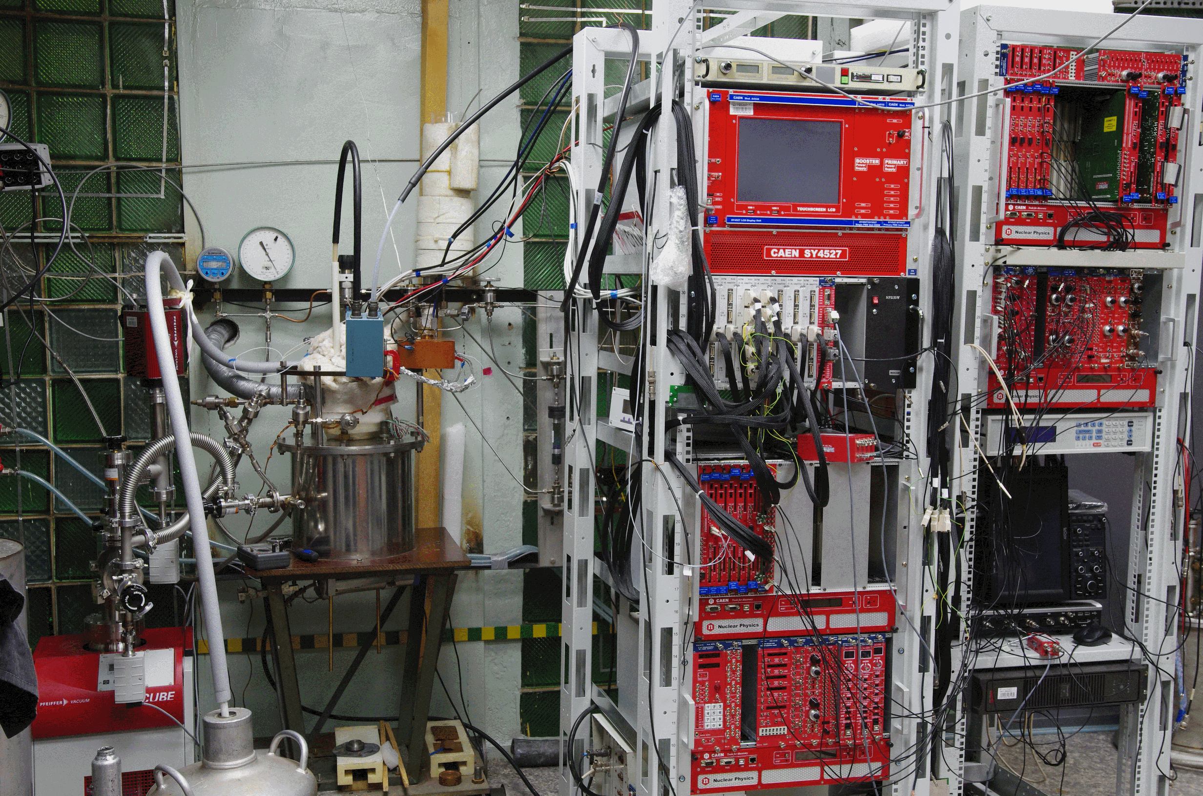
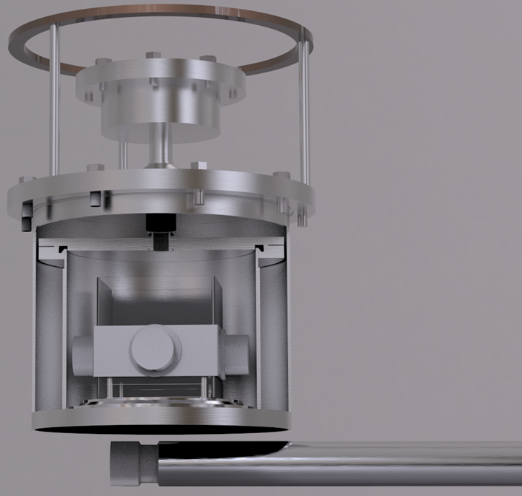
Экспериментальная установка
Сборка с ЭЛ зазором и считыванием на ФЭУ
Нейтронный
генератор
Вакуумно-изолированная девятилитровая двухфазная криогенная камера, заполненная 2.5 литрами жидкого Ar
Notes:
Наша экспериментальная установка содержит вакуумно-изолированную девятилитровую криогенную камеру с 2.5 литрами жидкого Ar.
Сборка с ЭЛ зазором и считыванием на ФЭУ расположена внутри криогенной камеры. Нейтронный генератор располагается на расстоянии 10 см от дна камеры.
В течение каждой процедуры сжижения Ar очищается от электроотрицательных примесей фильтром Oxisorb, что обеспечивает время жизни электронов в жидкости более 70 мкс.
2:00 – 3:00

Slide 3
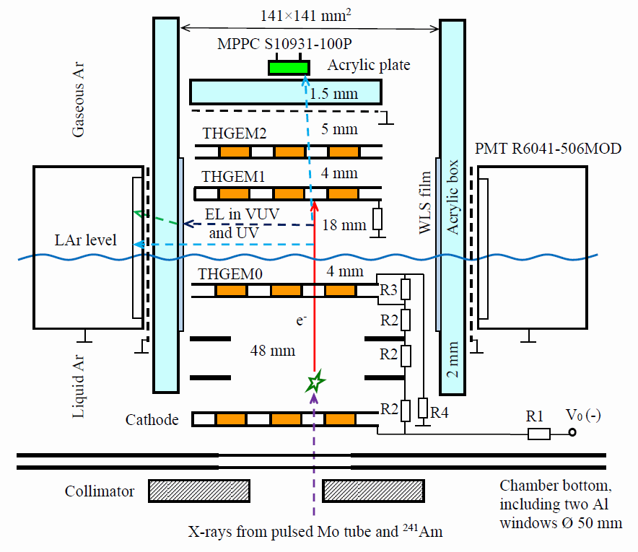
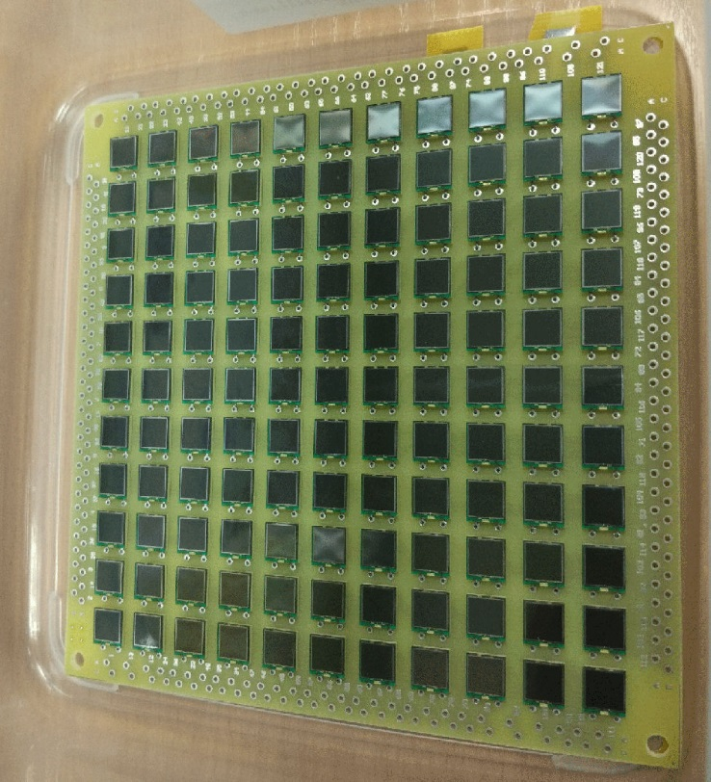
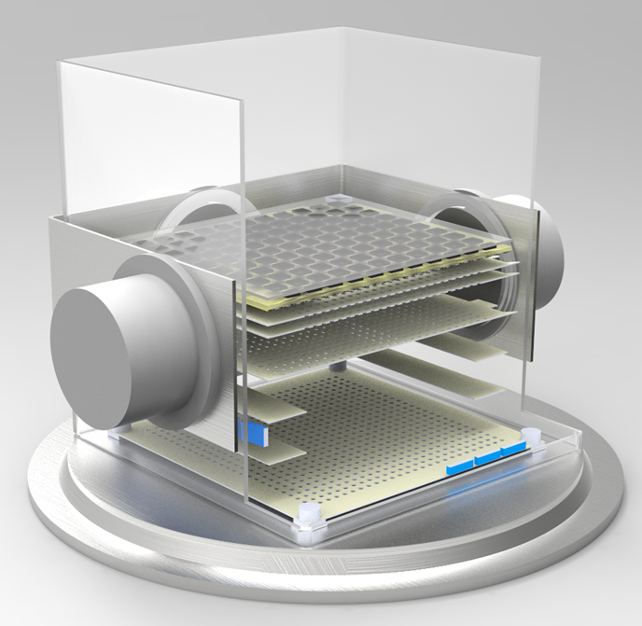
Криогенная камера
Hamamatsu
S13360-6050PE
6x6 mm²
11x11 matrix
Криогенная камера содержит катод, два полеформирующих электрода, a THGEM0, погруженный в жидкий Ar и двухкаскадную сборку THGEM, состоящую из THGEM1 and THGEM2, расположенных в газовой фазе над жидкостью.
ФЭУ
ЭЛ зазор
Дрейфовый промежуток
Notes:
The cryogenic chamber included a cathode electrode, two field-shaping electrodes, a THGEM0, immersed in liquid Ar layer
and a double-THGEM assembly, consisting of a THGEM1 and THGEM2, placed in the gas phase above the liquid.
The EL region was formed by the liquid surface and the THGEM1 plate.
There were two ways of optical readout of the EL gap.
Firstly, the gap was viewed by four compact cryogenic PMT, located on the perimeter of the gap.
Secondly, the scintillation in the spectral range other that VUV (NIR, for example) could be recorded using 11 by 11 SiMP matrix.
2:30 – 4:30

Slide 4
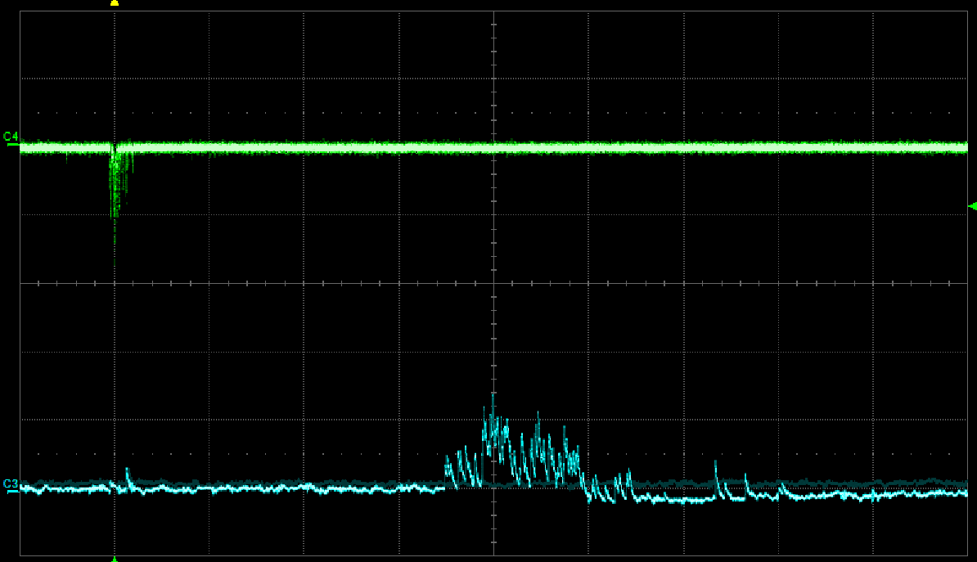
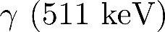
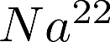
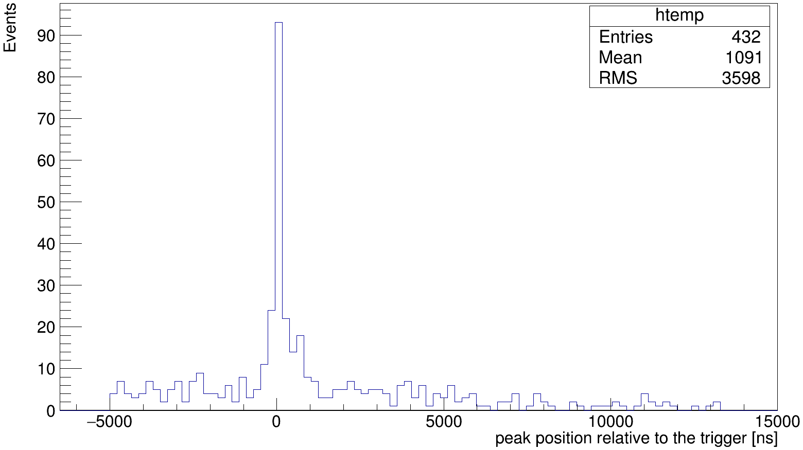
Регистрация S1 сигнала
КЛД облучался изотопом 22Na, который испускает два гамма-кванта.
Один из них регистрировался BGO счетчиком и давал триггер, а другой регистрировался в КЛД.
На спектре четко виден пик около времени триггера, поэтому сигнал действительно от изотопа.
Триггер (BGO счетчик)
Двухфазный КЛД
S2
S1
BGO счетчик
Временное распределение S1 сигнала относительно триггера
Notes:
Previously we used spectra subtraction to reject background events.
But also there is opportunity to use S2 S1 ratio as discriminator factor for nuclear and electron recoil.
We irradiated Cryogenic Avalanche Detector by sodium 22 isotope, which produce two gamma quanta.
One of them was detected by BGO counter and produced trigger and another one by CRAD.
The top right picture shows typical signals from detectors.
The bottom right picture shows S1 distribution of time delay with respect to the trigger
On this spectrum we clearly see peak near trigger time, so signals were really from sodium 22 isotope.
Unfortunately, S1 signal is low, so we plan to install additional SiMP matrix on the detector bottom and improve light collection.
13:00 – 14:10

Slide 5
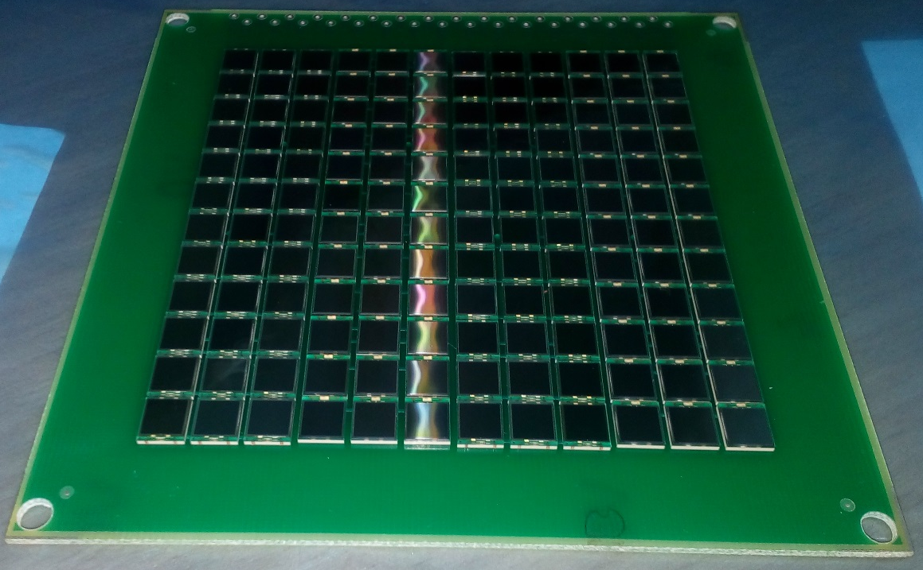
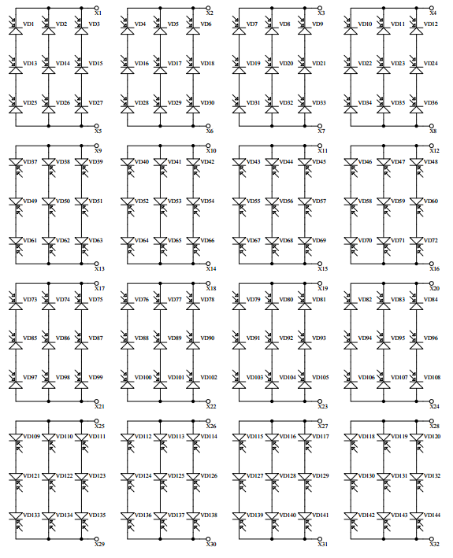
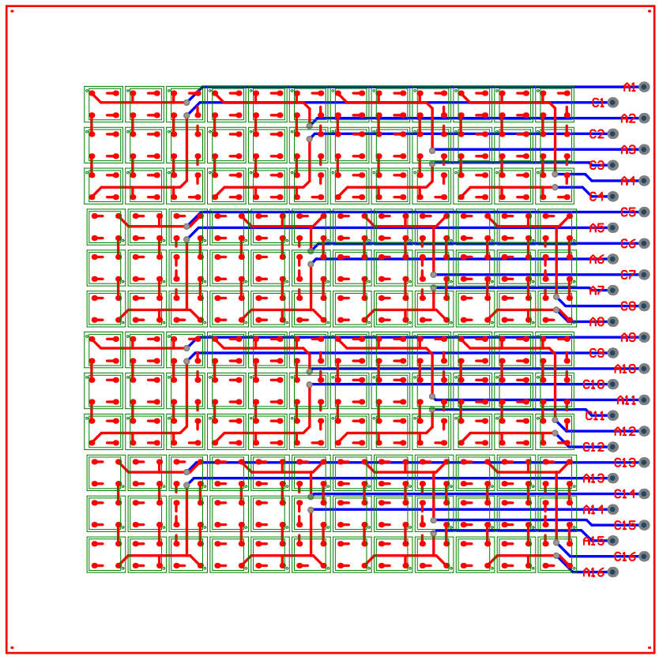
SiPM S13360-6050pe матрица 12x12
На данный момент протестировано 3s3p подключение с SiPM другой модели. Наблюдается стабильный режим работы и уменьшение площади сигнала в ~3 раза. На осень запланированы тесты новой матрицы.
Notes:
На данный момент протестировано 3s3p подключение с SiPM другой модели. Наблюдается стабильный режим работы и уменьшение площади сигнала в ~3 раза. На осень запланированы тесты новой матрицы.

Slide 6
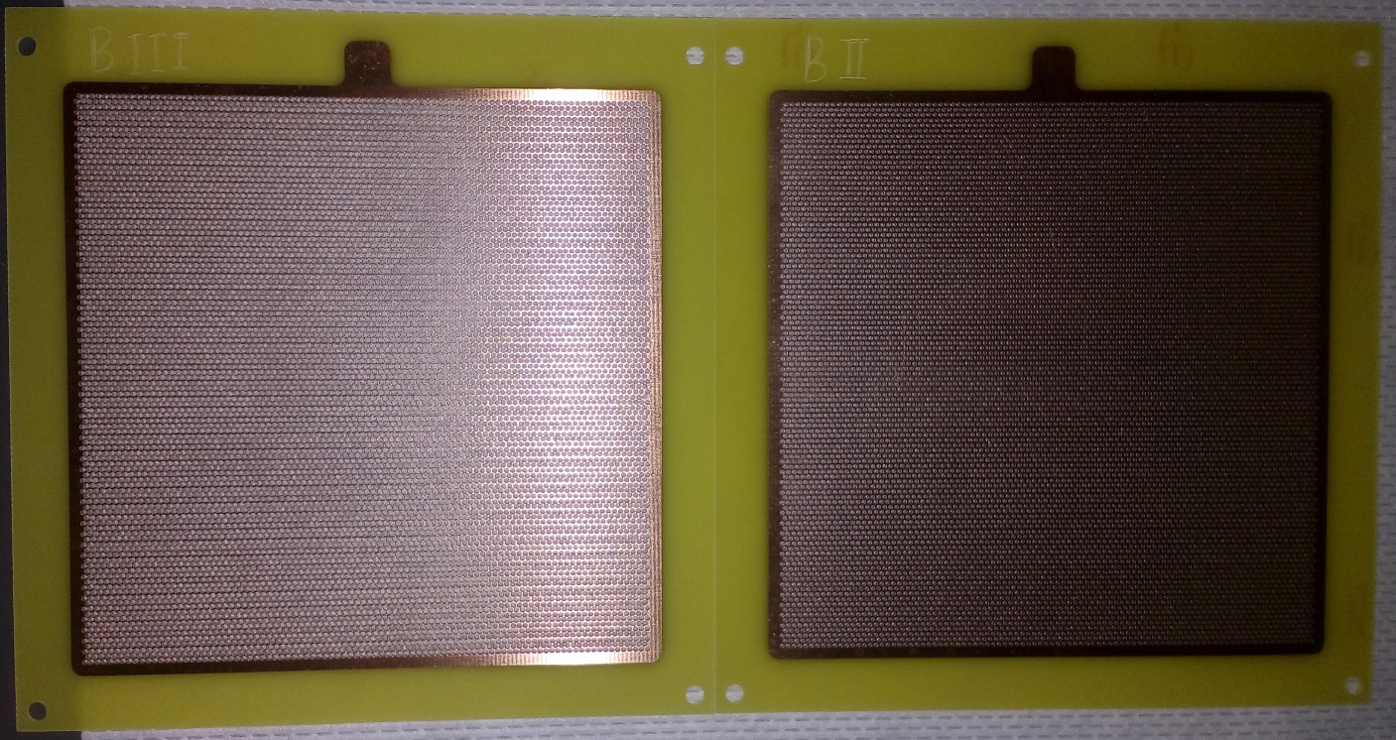
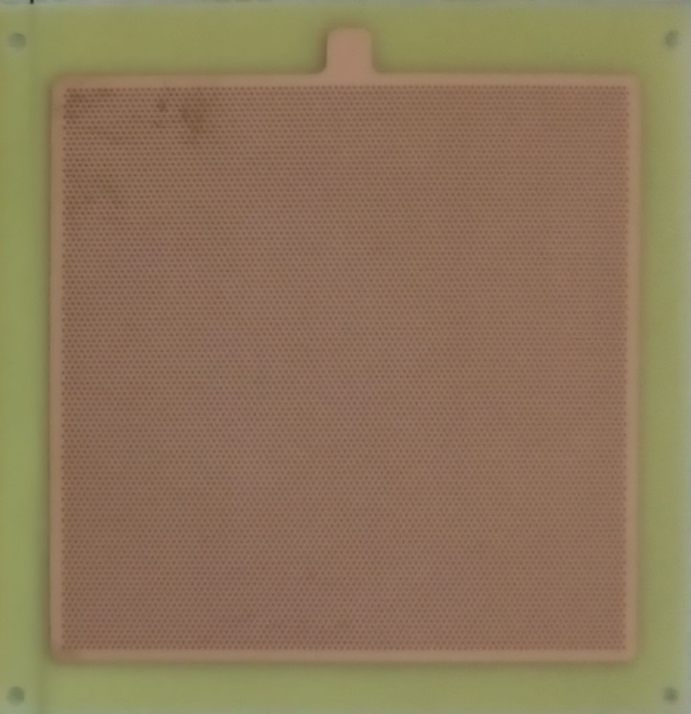
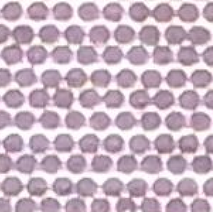
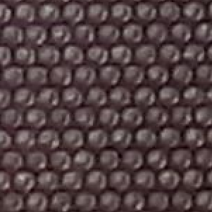

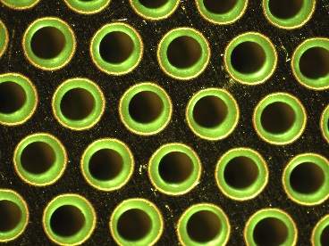
THGEM повышенной прозрачности
75%
48%
27%
Снимок с микроскопа
THGEM0 и THGEM1 с прозрачностью 27% будут заменены на новые THGEM с прозрачностью 48% или 75%. THGEM2 будет демонтирован. Это позволит существенно увеличить светосбор S1 компоненты на верхнюю матрицу SiPM.

Slide 7
Заключение
-Обработаны данные захода с источником 22Na. Выяснено, что S1 компонента сигнала имеет светосбор на ФЭУ на уровне одного-двух фотоэлектронов.
- Для увеличения светосбора изготовлены THGEM с большей прозрачностью и собрана матрица SiPM размером 12x12 элементов для установки на дно криогенной камеры, что имеет важное значение для реализации двойного рассеяния нейтронов.
- Данные исследования проводятся в рамках R&D программы для эксперимента DarkSide.
Notes:
To sum up,
16:00 – 17:00

Slide 8
Список опубликованных и готовящихся к публикации статей
- Bondar A. et al. Measurement of the ionization yield of nuclear recoils in liquid argon using a two-phase detector with electroluminescence gap // J. of Instrumentation. 2017. Vol. 12. C05010.
- Bondar A. et al. Further studies of proportional electroluminescence in two-phase argon // J. of Instrumentation. 2017. Vol. 12. C05016.
- Измерение ионизационных выходов ядер отдачи в жидком аргоне c помощью двухфазного детектора с оптическим считыванием (готовится к публикации в Вестник НГУ)
Notes:
To sum up,
16:00 – 17:00

Slide 9
Список выступлений на научных мероприятиях
-Instrumentation for Colliding Beam Physics (INSTR17) Conference, Новосибирск, 2017. Устный доклад.
- Конкурс Молодых Ученых, ИЯФ СО РАН, Новосибирск, 2017. Диплом 2-йстепени.
- International Session-Conference of the Section of Nuclear Physics of the PhysicalSciences Department of the Russian Academy of Sciences, Нальчик, 2017. Устный доклад.
Notes:
To sum up,
16:00 – 17:00

Slide 10
Backup slides

Slide 11
Измерение ионизационного выхода ядер отдачи в жидком аргоне методом рассеяния нейтронов
A. Bondar, A. Buzulutskov, A. Dolgov, E. Grishnyaev, V. Nosov,
V. Oleynikov (speaker), S. Polosatkin , L. Shekhtman, E. Shemyakina, A. Sokolov
Budker Institute of Nuclear Physics (Budker INP), Novosibirsk, Russia
Novosibirsk State University (NSU), Novosibirsk, Russia
Отчет о научно-исследовательской работе
20 июня, 2017
Научный руководитель - Бузулуцков Алексей Федорович доктор физико-математических наук, профессор, главный научный сотрудник
Notes:
Здравствуйте!
Тема моей работы “Измерение ионизационного выхода ядер отдачи в жидком аргоне методом рассеяния нейтронов”
0:00 – 0:15

Slide 12
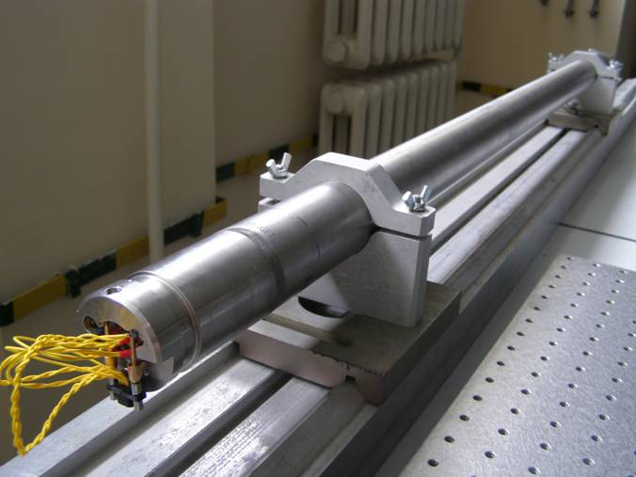
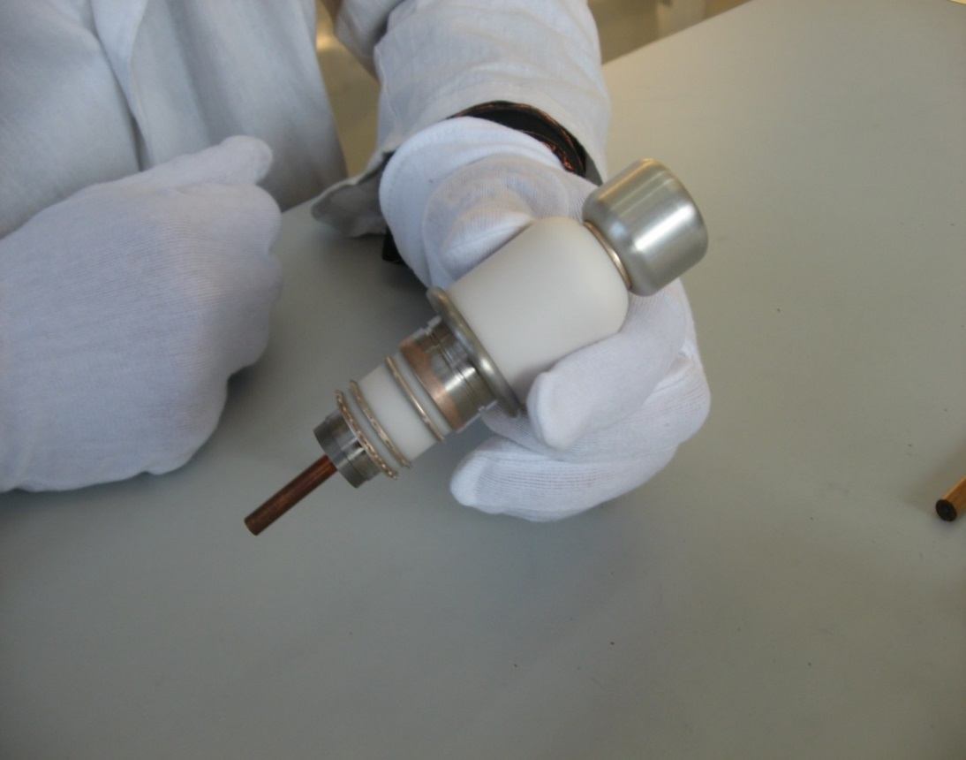
Neutron generator produced in BINP
To produce neutrons, a specially designed neutron generator was used that continuously emitted monoenergetic not collimated neutrons with a kinetic energy of 2.45 MeV obtained in the DD fusion reaction.
The design parameters:
Neutron yield: 10⁵ neutrons/s
Nominal current of ions: 50 uA
Operating voltage: 80 kV
Insulation: SF₆, 8 atm
Notes:
To produce neutrons a specially designed neutron generator was used that continuously emitted monenergistic not collimated neutrons with a kinetic energy of 2.45 MeV obtained in the DD fusion reaction.
The Design parameters of the neutron generator are:
Neutron yield: 10⁵ neutrons/s (ten to the fifth power)
Rated current of ions: 50 uA (microamps)
Operating voltage: 80 kV (kilovolts)
Insulation: SF₆, 8 atm (sulfur hexafluoride at eight atmospheres)
4:30 – 5:30

Slide 13
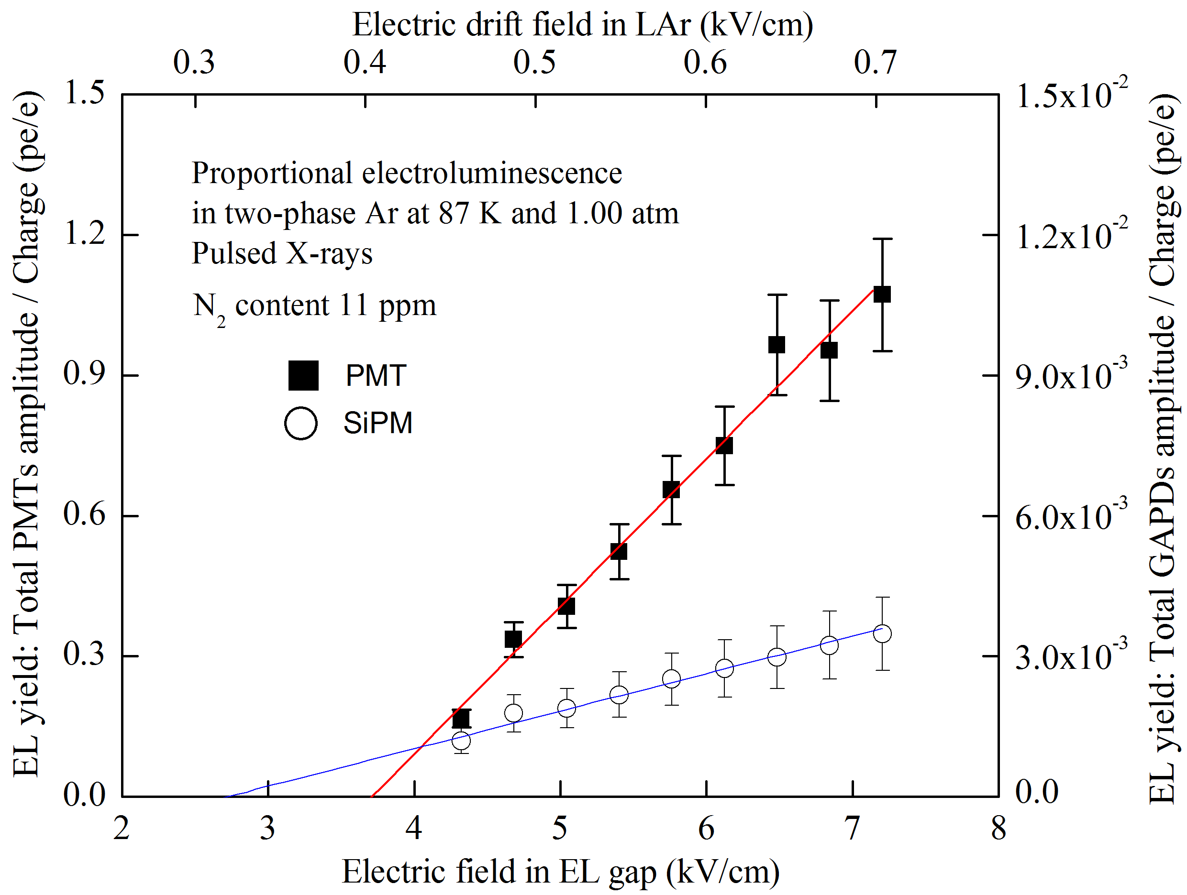
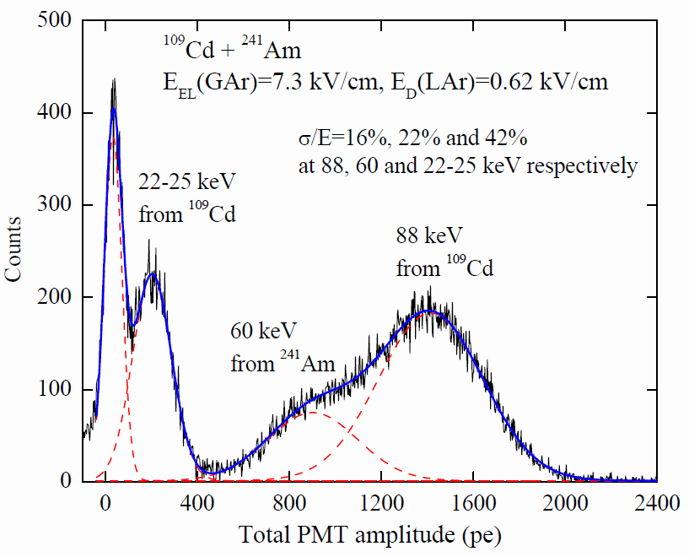
Study of proportional EL in two-phase Ar:
EL yields and amplitude spectra
The EL gap yield as a function of the electric field in the gap, measured using PMT or SiPM signals. The amplitude spectrum of the total PMT signal from the EL gap induced by X-ray from a mixture of the Cd and Am radioactive sources.
High EL gap yield of 15 pe/keV (1 pe/e) and good energy resolution of 22% at 60 keV have been reached at an electric field of 7 kV/cm in the EL gap.
Notes:
Study of proportional EL in two-phase Ar has been carried out.
The left picture shows the EL gap yield as a function of the electric field in the gap, measured using PMT or SiPM signal.
The right picture shows the amplitude spectrum of the total PMT signal from the EL gap induced by X-ray from a mixture of the Cd and Am radioactive sources.
High EL gap yield: 15 pe/keV (1.4 pe/e) and good energy resolution: 22% at 60 keV have been reached at 7 kV/cm field in the EL gap.
5:30 – 6:30

Slide 14
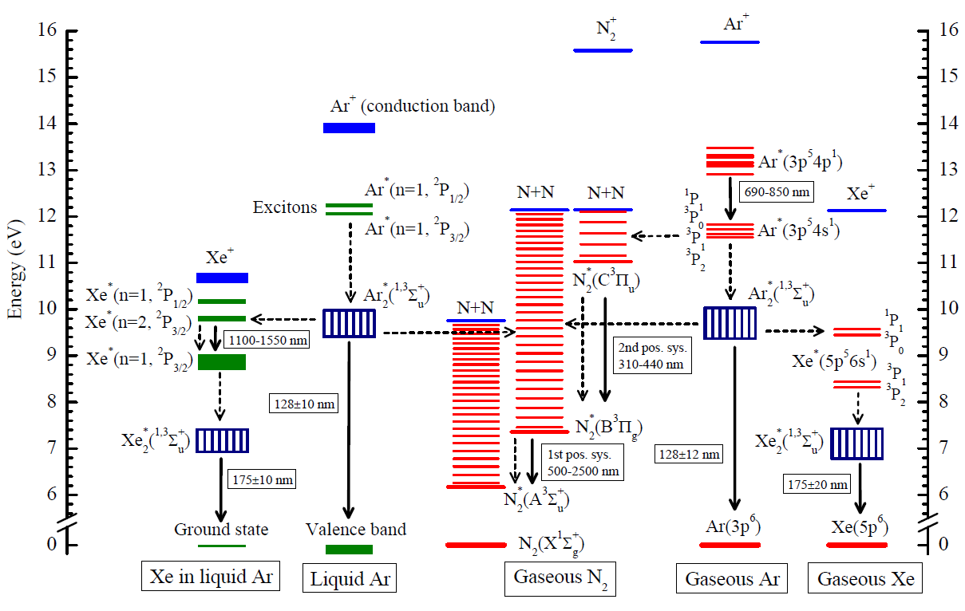
The problem of doping Ar with Xe and N2
Photon emission and atomic collision processes in two-phase argon doped with xenon and nitrogen: the most complete compilation over past 50 years (A. Buzulutskov, Eprint 1702.03612).
The problem is currently under study in our group. You can find details in the article.
Notes:
Recently, we have presented a comprehensive analysis of photon emission and atomic collision processes in two-phase argon doped with xenon and nitrogen.
The problem is currently under study in our group.
You can find details in the article.
6:30 – 7:30

Slide 15
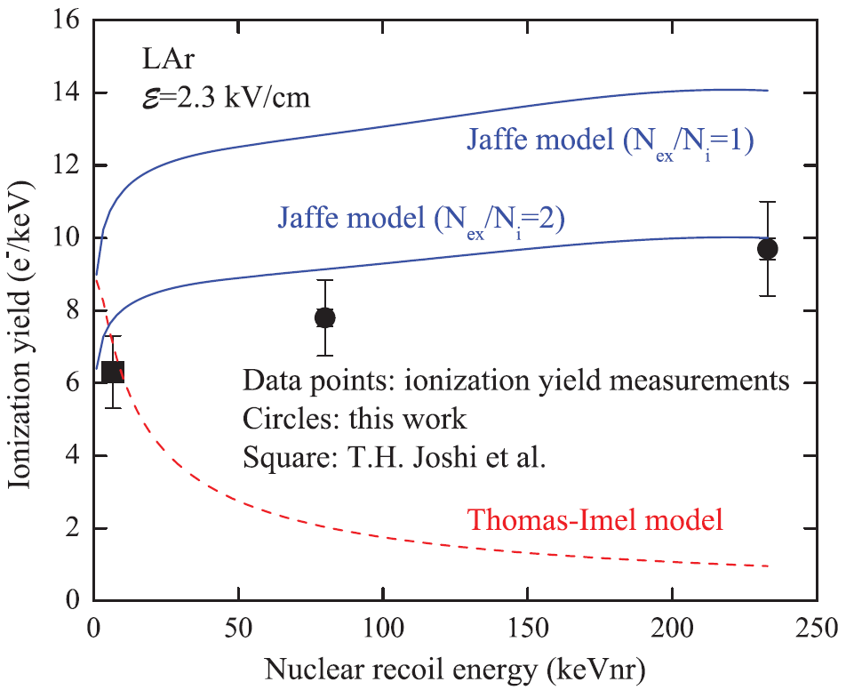
Ionization yield
A particle interaction in the liquid phase produces primary scintillation (S1) and ionization.
The electrons are drifted away from the interaction site by an electric field and extracted into the gas where they create secondary scintillation (S2).
The ionization yield is the ratio of the number of electrons escaping recombination with positive ions (ne) and the energy deposited by a nuclear recoil (E).
Recently we have measured ionization yields of nuclear recoils in liquid argon at 80 and 233 keV (EPL, 108 (2014) 12001)
In present work the ionization yield of nuclear recoils in liquid Ar has been measured at high energy 233 keV for several electric fields.
Notes:
The experimental setup and its main parameters have been described previously and now we’ll discuss Measurement of the ionization yield.
A particle interaction in the liquid phase produces primary scintillation (S1) and ionization .
The electrons are drifted away from the interaction site by an electric field and extracted into the gas where they create secondary scintillation (S2).
The ionization yield is ratio of number of electrons escaping recombination with positive ions (ne) and the energy deposited by a nuclear recoil (E).
While for liquid Xe there are ample experimental data on such yields, little is known about it in liquid Ar.
Recently we have measured ionization yield of nuclear recoils in liquid argon at 80 and 233 keV (see the picture).
In present work the ionization yield of nuclear recoils in liquid Ar has been measured at high energy 233 keV for several eclectic fields.
7:30 – 10:00

Slide 16
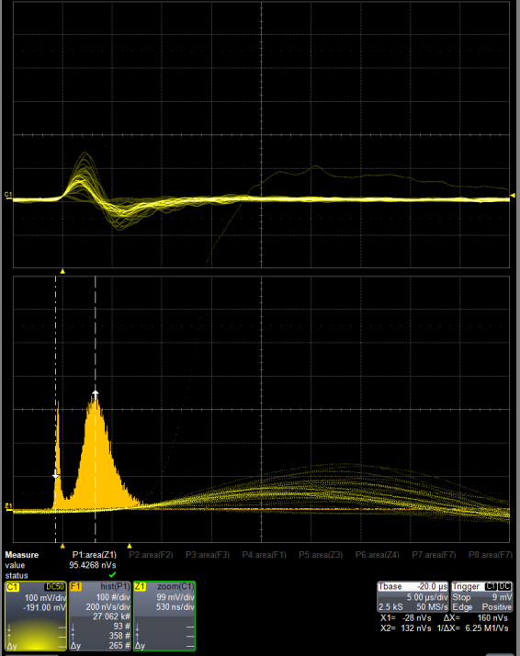
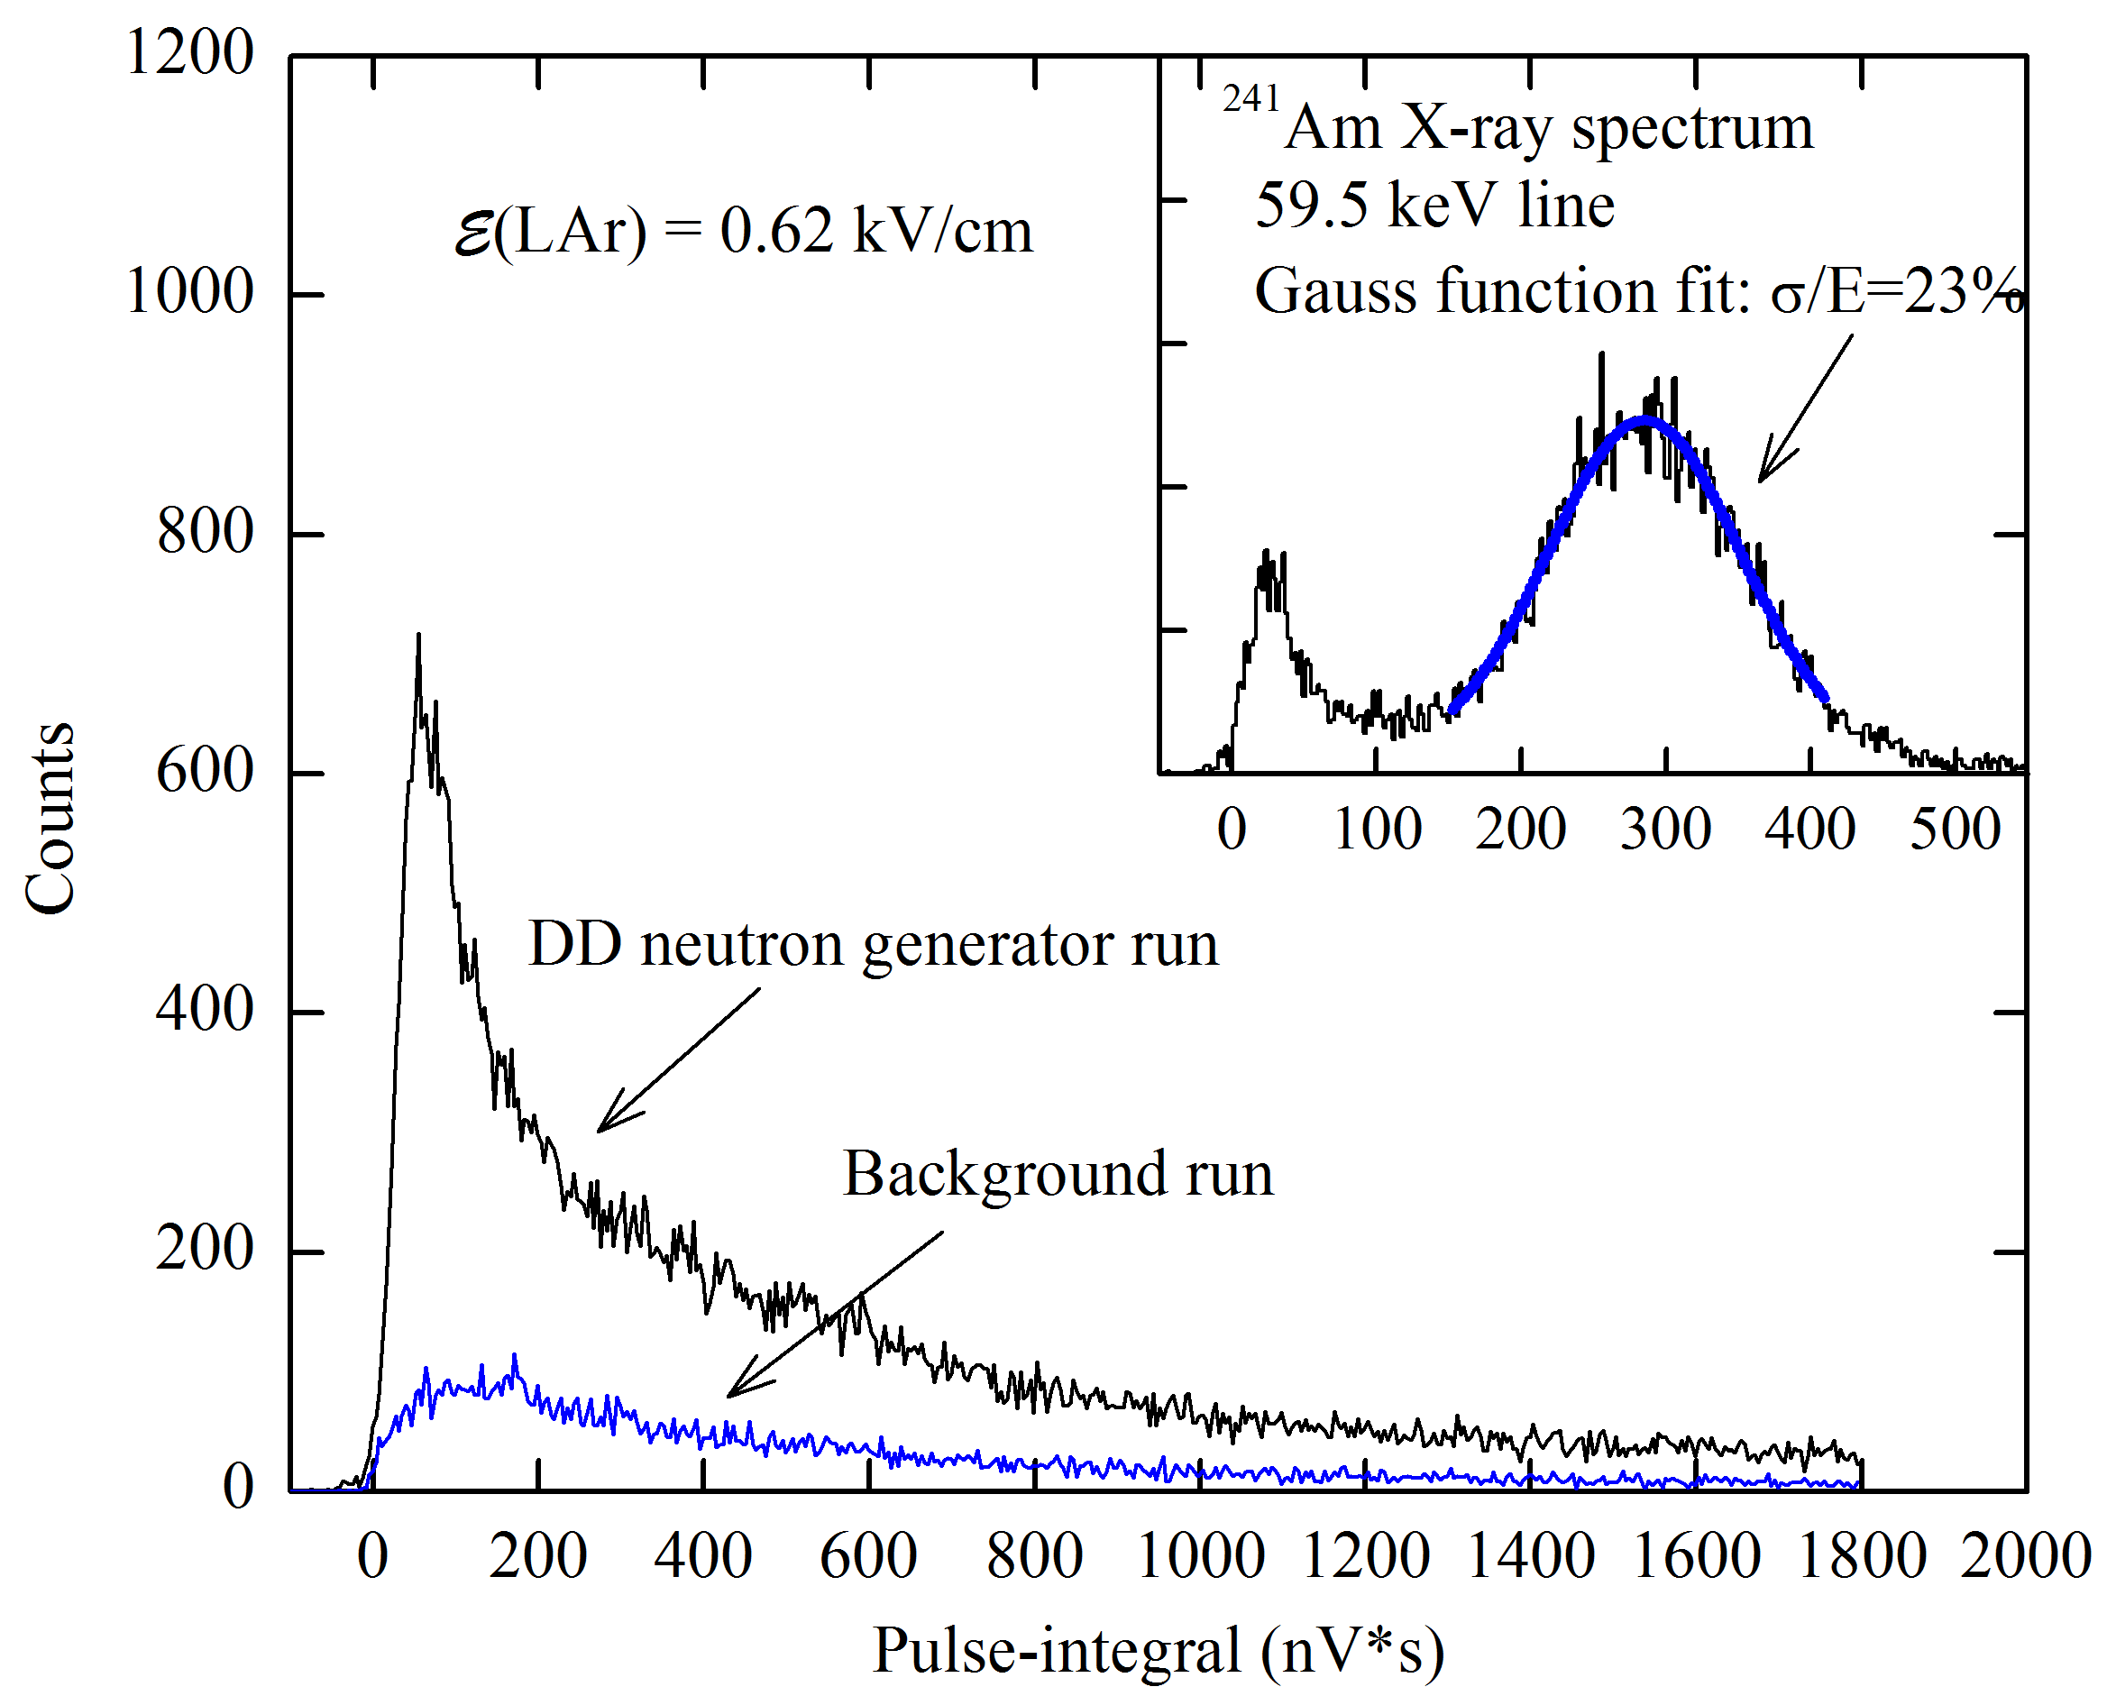
Measurement of ionization yield: raw signals
The primary ionization charge in liquid Ar was produced by either 60 keV gamma from 241Am or 2.45 MeV neutron from the DD-generator.
A typical oscillogram with a raw signal and an integral spectrum for Am isotope.
The integral spectra for Am, neutron and background runs.
Notes:
The primary ionization charge in liquid Ar was produced by either 60 keV gamma from 241Am or 2.45 MeV neutron from DD-generator.
The left picture shows a typical oscillogram with a raw signal and an integral spectrum for Am isotope.
The right picture shows the integral spectra for Am, neutron and background runs.
10:00 – 10:40

Slide 17
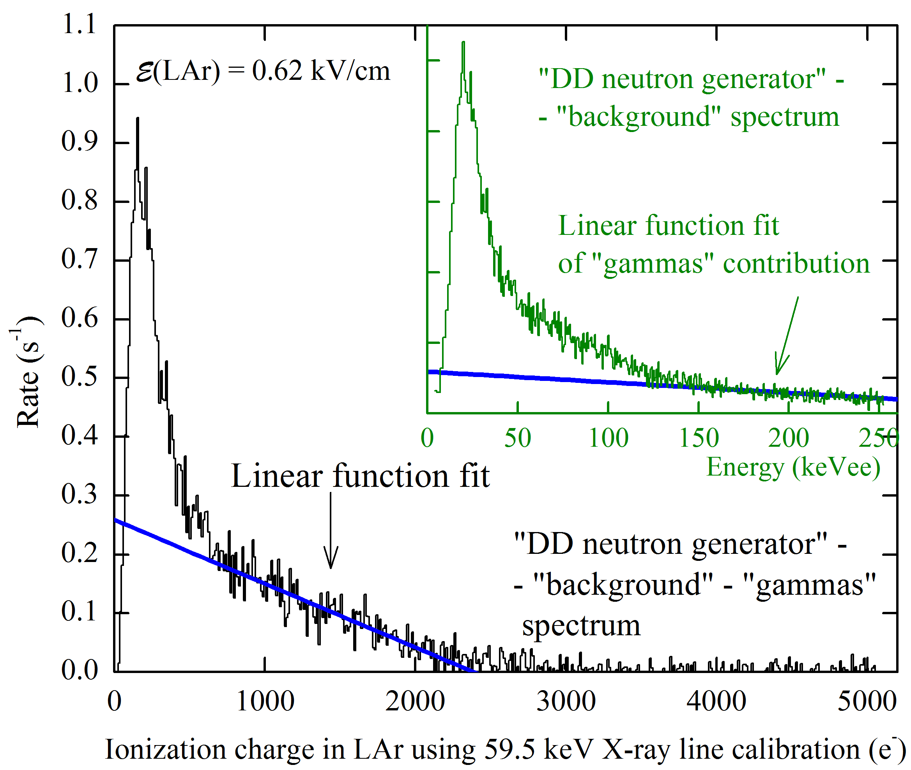
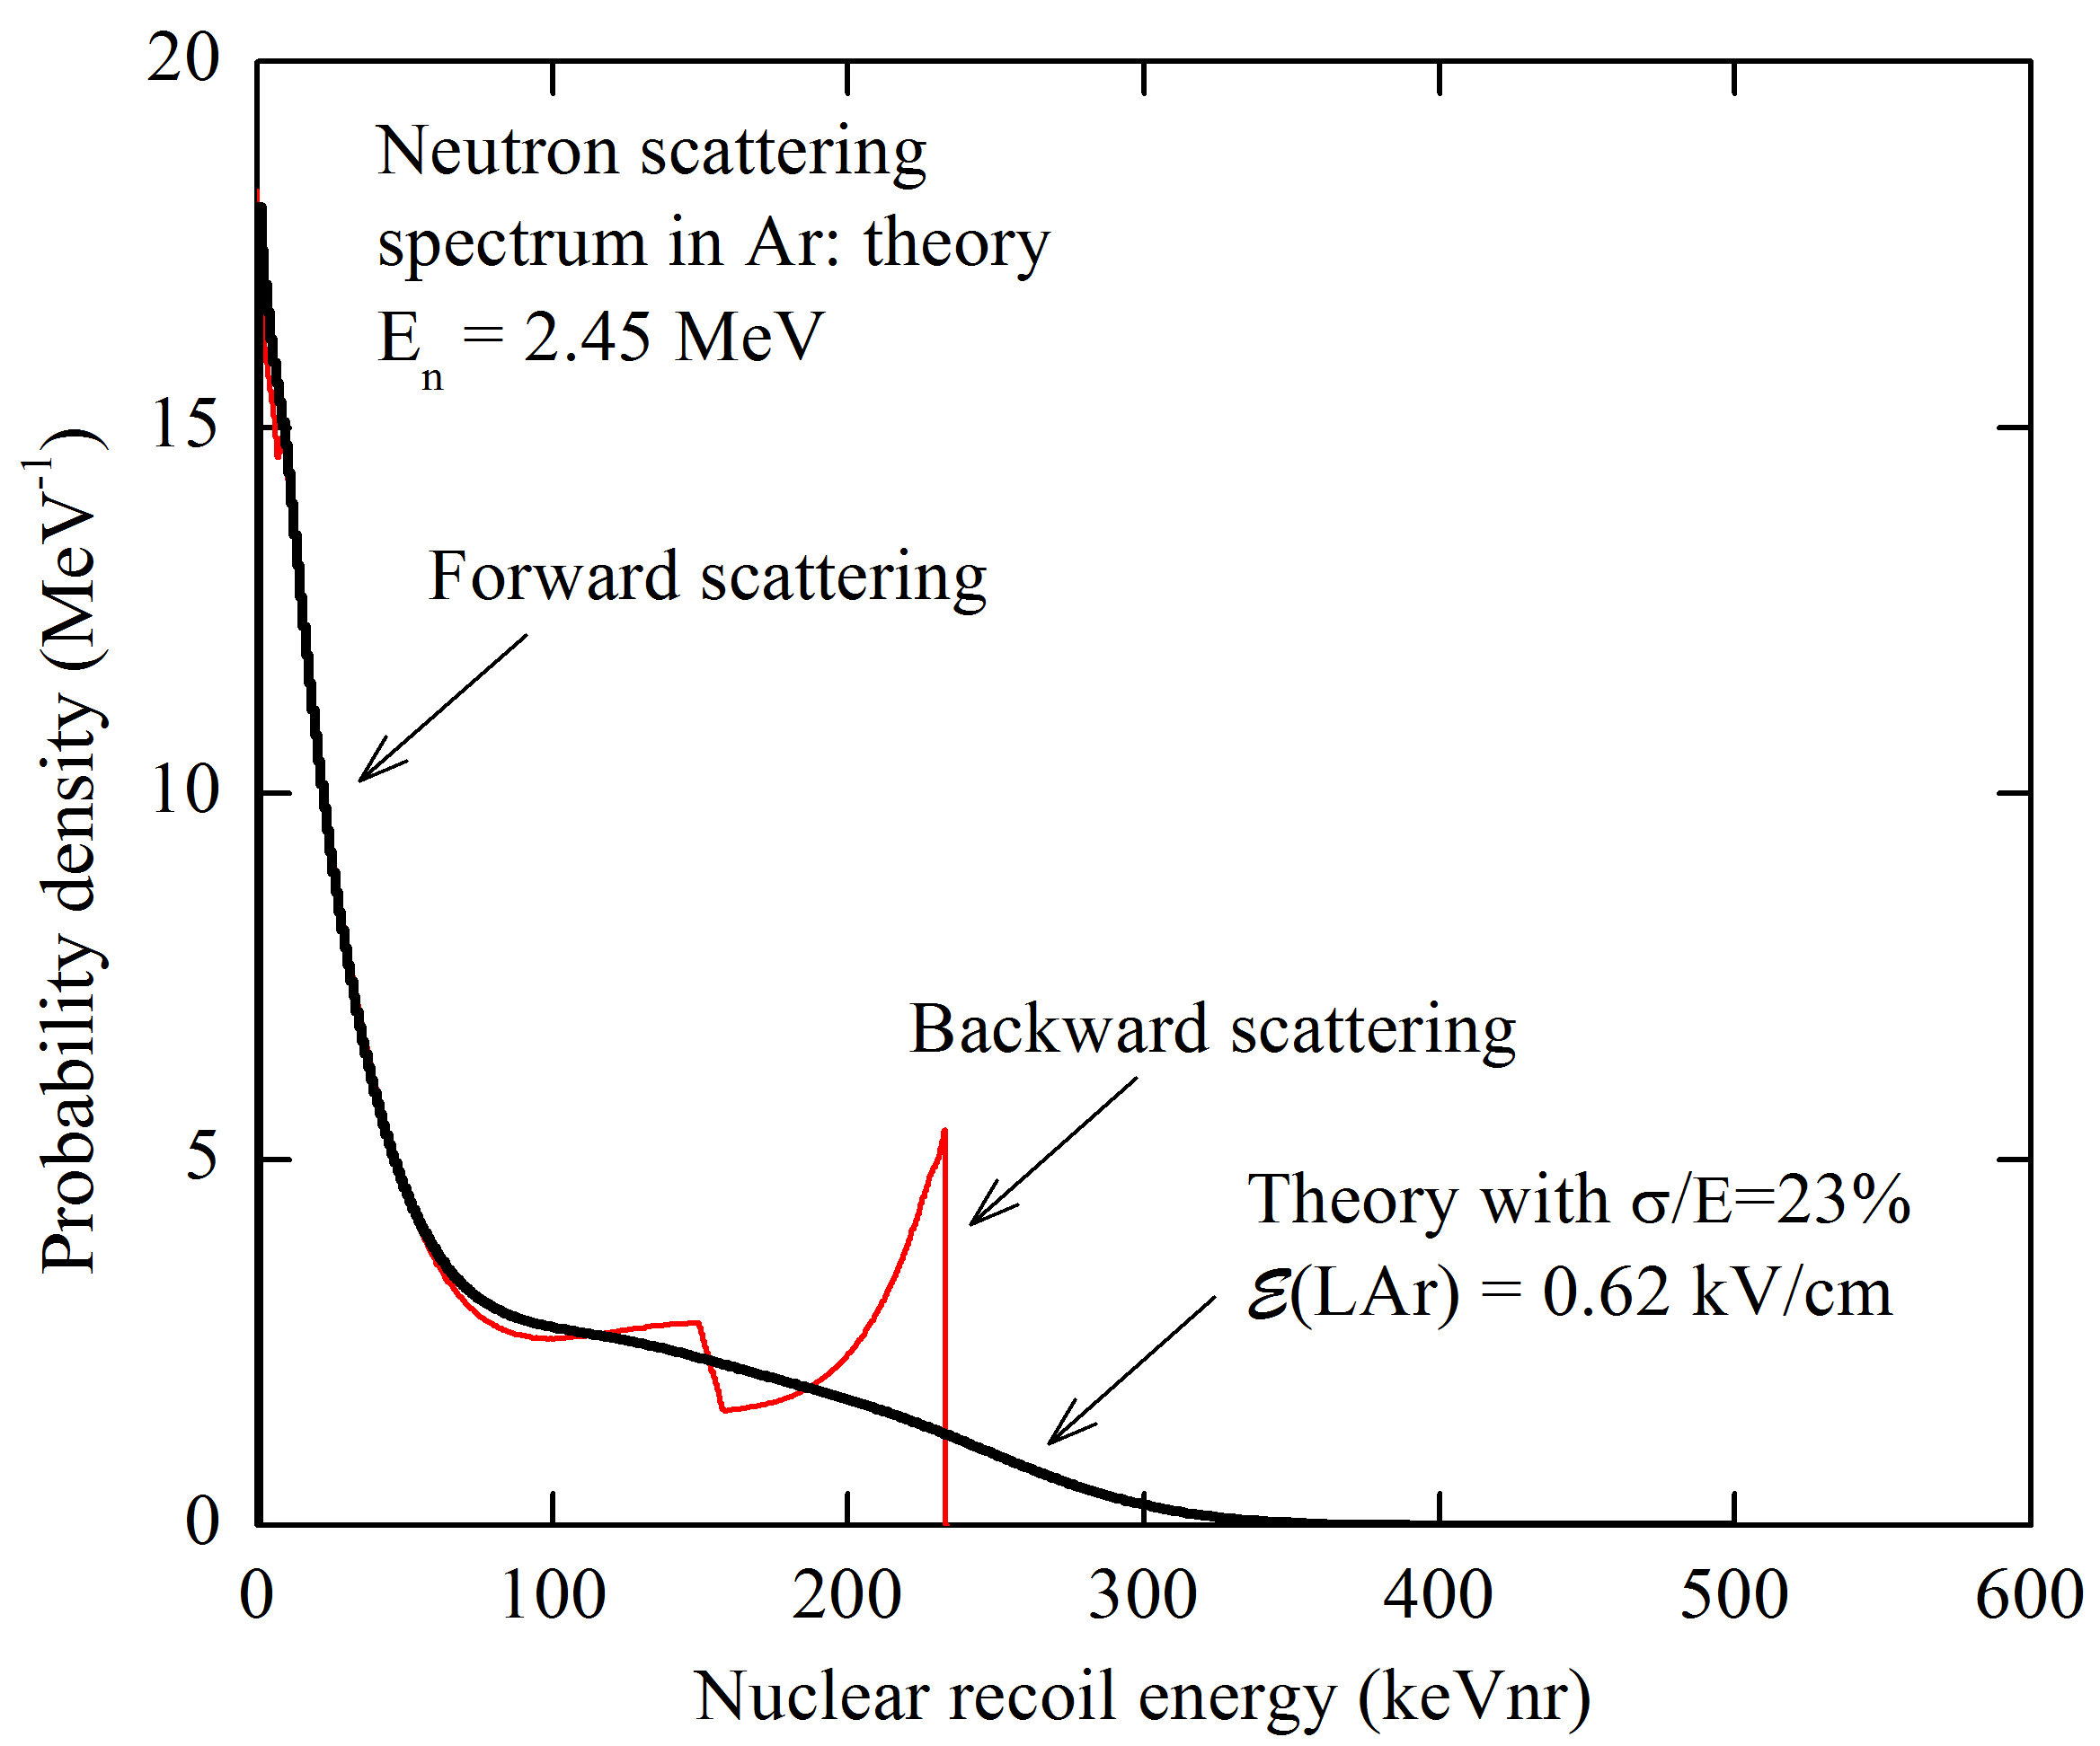
Measurement of ionization yield: experimental and theoretical spectra
To measure the ionization yield we subtracted the background-run contribution from the neutron run. After this we subtracted the gamma-ray contribution, resulting from a radiative capture in surrounding materials. Finally, the pulse integral was normalized to that of 60 keV peak and we found a spectrum end-point in units of ne.
The theoretical spectrum was convolved with an energy resolution function.
The ionization yield was calculated by dividing the end point of experimental spectrum to the theoretical one.
Notes:
To measure ionization yield we subtracted the background-run contribution from the neutron run(see the top left picture).
After this we subtracted the gamma-ray contribution, resulted from a radiative capture in surrounding materials (see the bottom left picture).
Finally, the pulse integral was normalized to that of 60 keV peak and we found a spectrum end-point in units of ne (number of electrons escaping recombination with positive ions unit.)
The theoretical spectrum (red curve on the right picture) was convolved with energy resolution function (the result of convolution is black curve).
The Ionization yield was calculated by dividing the end point of experimental spectrum to the theoretical one.
10:40 – 12:10

Slide 18
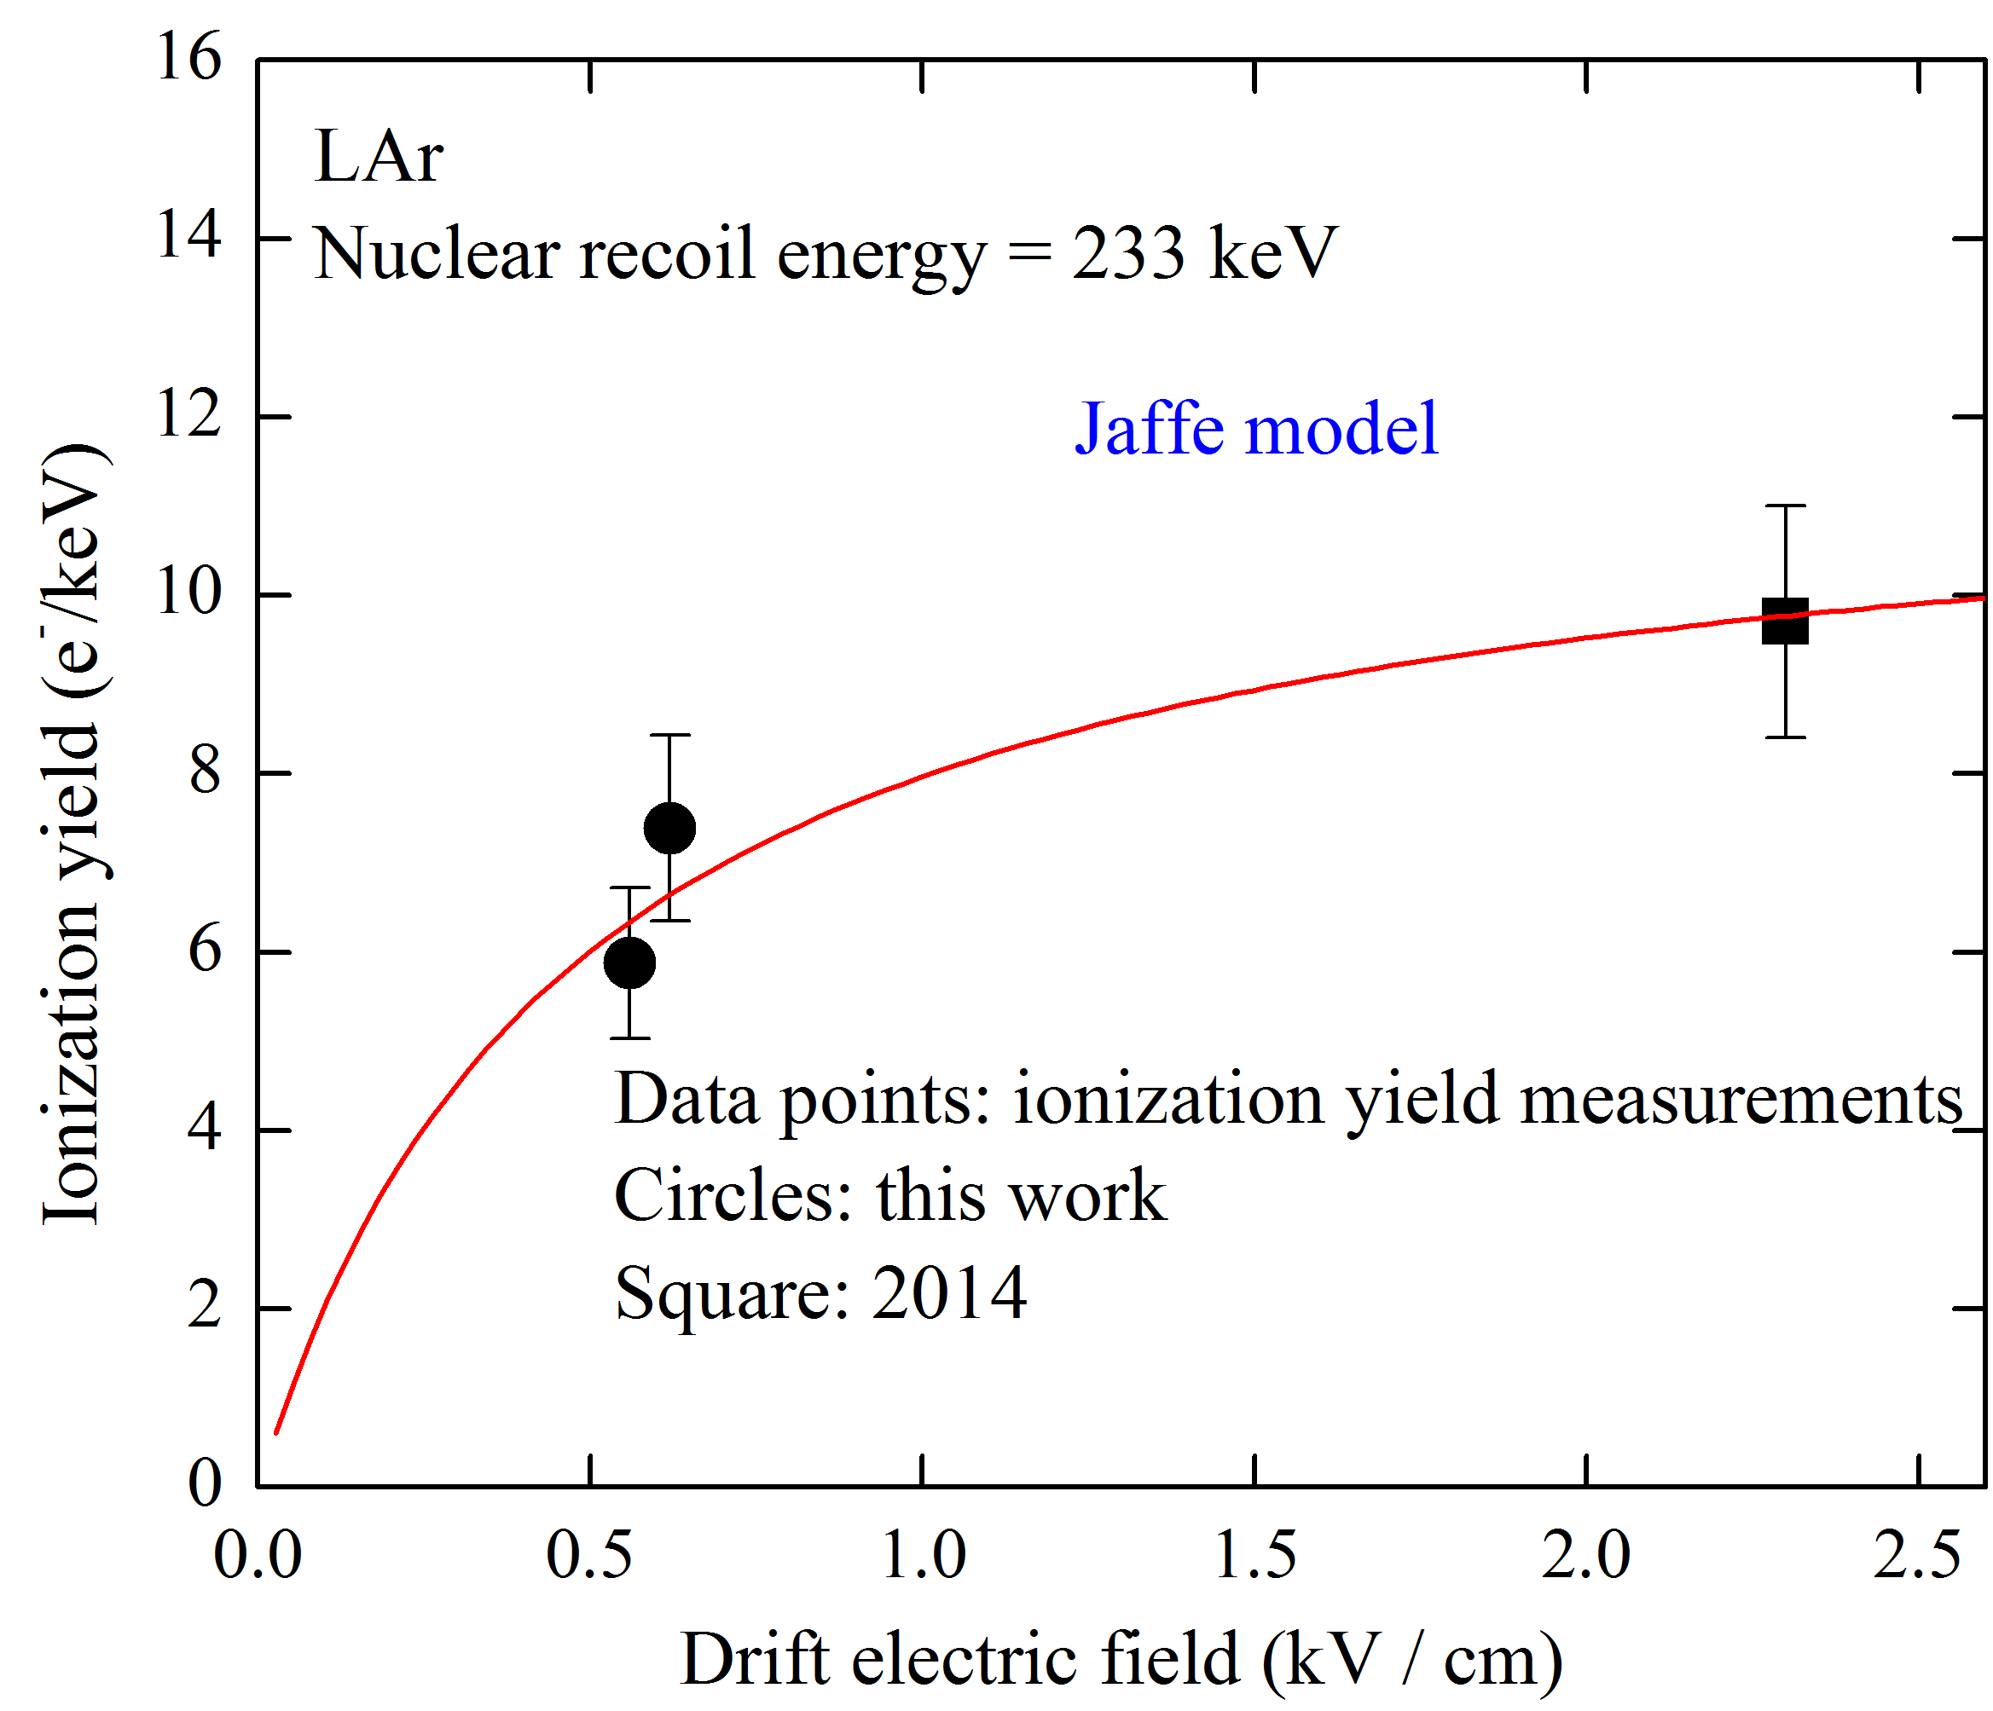

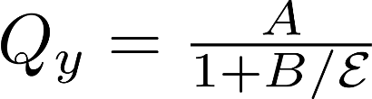
Measurement of ionization yield: results
Ionization yield:
5.9 +- 0.8 and 7.4 +- 1 e-/keV at 0.56 and 0.62 kV/cm
A field dependence is well described by Jaffe model (red curve).
A systematic error is dominant and occurs because of using liquid Ar ionization yield of electron recoil for calibration.
Notes:
On the graph you can see the ionization yield as a function of electric field for two data sets:
Square for previous data obtained in 2014 and circles for current data.
A field dependence is well described by Jaffe model (red curve ).
A systematic error is dominant and occurs because of using liquid Ar ionization yield of electron recoil for calibration.
12:10 – 13:00

Slide 19
Towards nuclear recoil selection using S1/S2 signals
Two-phase CRAD
Trigger (BGO counter)
S2
S1
BGO counter
Previously we used spectra subtraction to reject background events, but there is also opportunity to use S2 / S1 as discriminator factor for nuclear and electron recoil.
We irradiated Cryogenic Avalanche Detector by 22Na isotope, which produce two gamma quanta. One of them was detected by BGO counter and produced trigger and another one was detected by CRAD.
Unfortunately, S1 signal is low, so we plan to install additional SiMP matrix on the detector bottom and improve light collection.
Notes:
Previously we used spectra subtraction to reject background events, but also there is opportunity to use S2 S1 ratio as discriminator factor for nuclear and electron recoil.
We irradiated Cryogenic Avalanche Detector by sodium 22 isotope, which produce two gamma quanta.
One of them was detected by BGO counter and produced trigger and another one was detected by CRAD.
The right picture shows typical signals from detectors.
Unfortunately, S1 signal is low, so we plan to install additional SiMP matrix on the detector bottom and improve light collection.
13:00 – 14:10

Slide 20
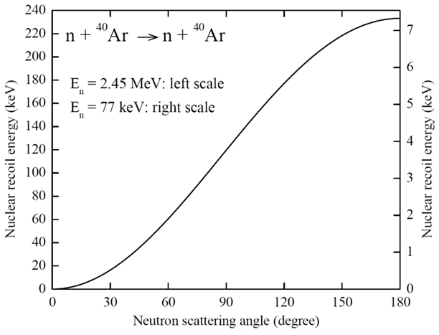
Neutron double-scattering concept for low-energy calibration in LAr
The double-scattering concept has been recently realized in LXe in LUX experiment [arXiv:1608.05381]
Cryostat
SiPM matrix
α
Recoil energy dependence as a function of the neutron scattering angle
n
10cm
n
D-D neutron generator
Having high spatial resolution, of 1 mm, we expect reaching accuracy of about 2º in scattering angle, corresponding to nuclear recoil energy as low as a few keV.
Notes:
When we will reach sufficient light collection, we plan to realize Neutron double-scattering concept.
This concept has been recently realized in LXe in LUX experiment .
The main idea of this experiment was to register scattered neutron again in the TPC.
The left picture shows a scheme of this experiment.
The right picture shows recoil energy dependence as a function of the neutron scattering angle.
Having high spatial resolution in detector, of 1 mm, we expect reaching accuracy of about 2º in scattering angle, corresponding to nuclear recoil energy as low as a few keV
14:10 – 16:00

Slide 21
Photon emission and atomic collision processes in two-phase argon doped with xenon and nitrogen
–We present a comprehensive analysis of photon emission and atomic collision processes
in two-phase argon doped with xenon and nitrogen. The dopants are aimed to convert the VUV
emission of pure Ar to the UV emission of the Xe dopant in the liquid phase and to the near
UV emission of the N2 dopant in the gas phase. Such a mixture is relevant to two-phase dark
matter and low energy neutrino detectors, with enhanced photon collection efficiency for primary and secondary scintillation signals.
Based on this analysis, it is shown that Xe dopant may successfully perform its job on VUV-to-UV conversion in the liquid phase even in presence of N2 impurity, if its content does not exceed 50 ppm.

Slide 22
Novosibirsk group presentation
Novosibirsk group on rare-event instrumentation operates within both Budker Institute of Nuclear Physics (BINP) and Novosibirsk State University (NSU), in the frame of Lab 3 (BINP) and LCEP (Laboratory of Cosmology and Elementary Particles of Physics Department of NSU).
Also, we have recently joined DarkSide20k collaboration.
Group management:
A. Buzulutskov (leader), A. Bondar (deputy director of BINP and dean of Physics Department of NSU), A. Dolgov (head of LCEP).
Group members:
A. Sokolov (senior scientist), L. Shekhtman (leading scientist), V. Nosov (engineer), R. Snopkov (engineer), E. Shemyakina (PHD student), V. Oleinikov (PHD student), A.Chegodaev (technician).
We also collaborate with S. Polosatkin and E. Grishnyaev from Plasma Division (BINP) on DD neutron generator development.
Notes:
Novosibirsk group on rare-event instrumentation operates within both Budker Institute of Nuclear Physics (BINP) and Novosibirsk State University (NSU), in the frame of Lab 3 (BINP) and LCEP (Laboratory of Cosmology and Elementary Particles of Physics Department of NSU).
Also, we have recently joined DarkSide20k collaboration

Slide 23
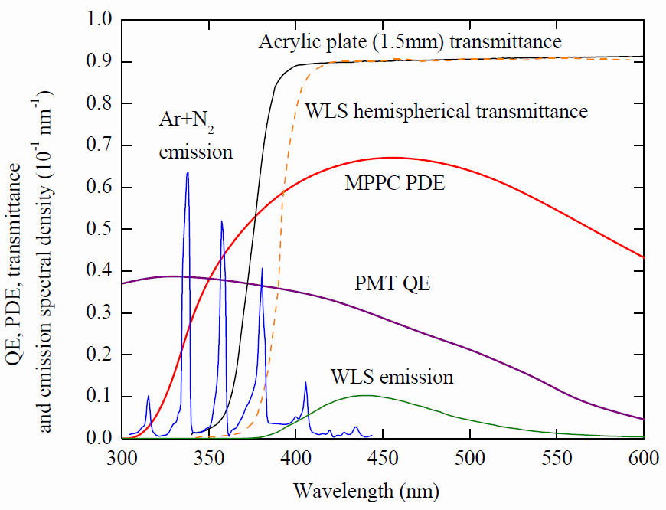
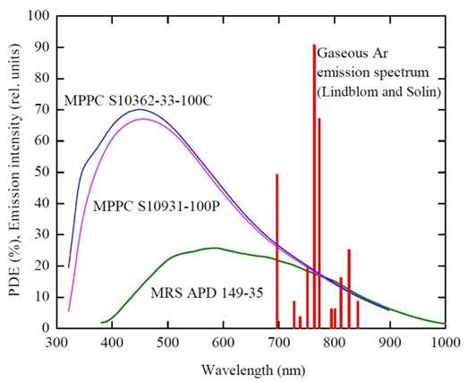
Optical spectra

Slide 24
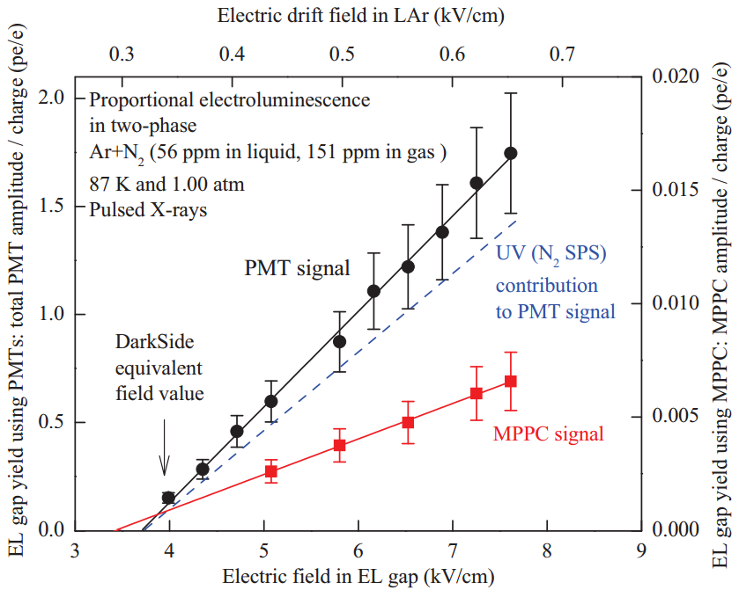
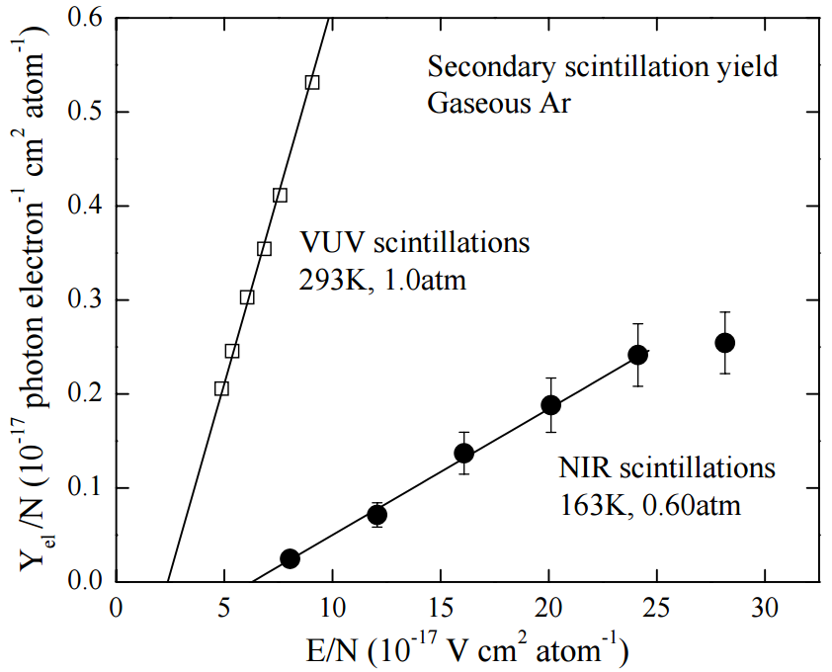
Resolving problem of EL yield is in the progress.
EPL, 94 (2011) 52001
EPL, 112 (2015) 19001
Current result

Slide 25
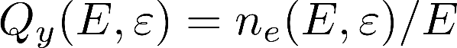
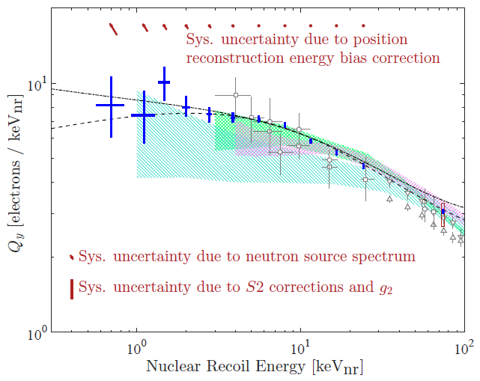
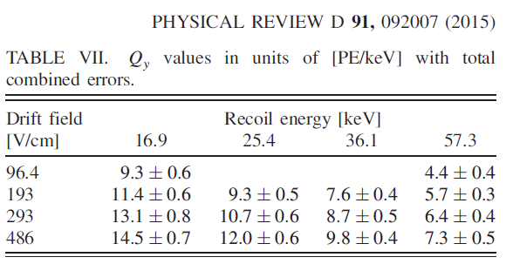
Ionization yield
(LXe): 0.7 – 100 keVnr
SCENE experiment (LAr):
17 – 57 keVnr, but in [PE/keVnr]
Notes:
The energy calibration of nuclear recoil detectors is of primary importance to rare-event experiments.
Such a calibration, in particular in liquid Ar and Xe detectors media, is usually performed by measuring the ionization yield and scintillation efficiency of nuclear recoil, using neutron elastic scattering on (off ?) nuclei,
which imitating the interaction with dark matter particle or coherently scattered neutrino.
A particle interaction in the liquid phase produces primary scintillation (S1) and ionization [5]. The electrons are drifted away from the interaction site by an electric field and extracted into the gas where they create secondary scintillation (S2).
The ionization yield is ratio of number of electrons escaping recombination with positive ions (ne) and the energy deposited by a nuclear recoil (E).
It depends on deposited energy (E) and on the electric field (epsilon).
While for liquid Xe there are ample experimental data on such yields, little is known about the ionization yield and scintillation efficiency in liquid Ar.
Recently the first results on the ionization yield of nuclear recoils in liquid argon have been presented in the low energy range.
SCENE collaboration presented results from 17 to 57 keV, but in [PE/keVnr], i.e. detector-dependent units.
6.7 keV and from In present work ionization yield of nuclear recoils in liquid Ar has been measured at high energy 233 keV and complements low energy data.

Slide 26
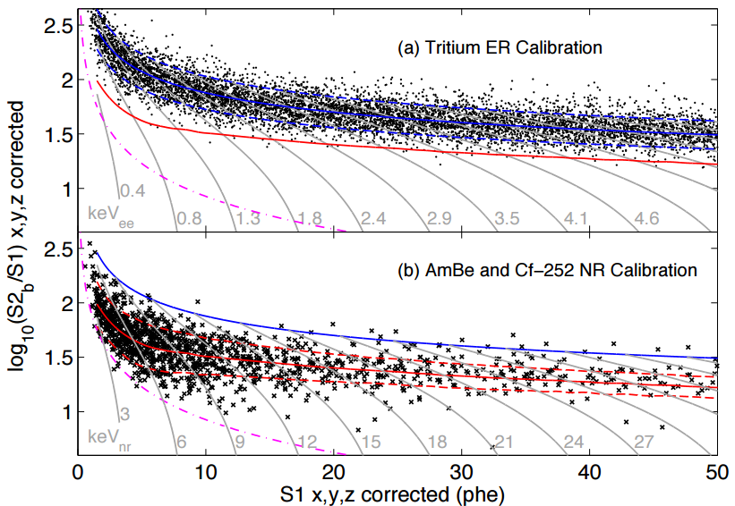
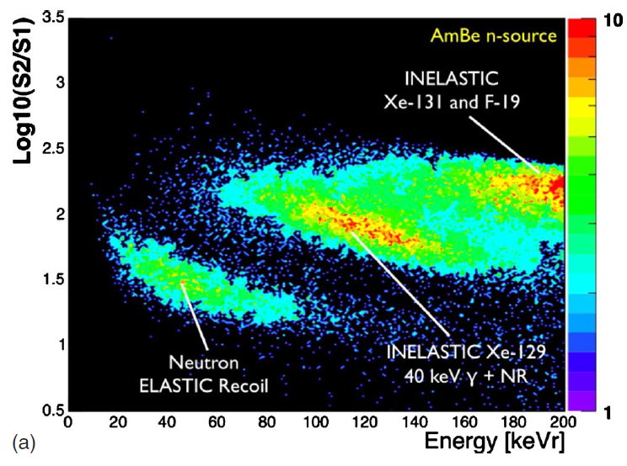
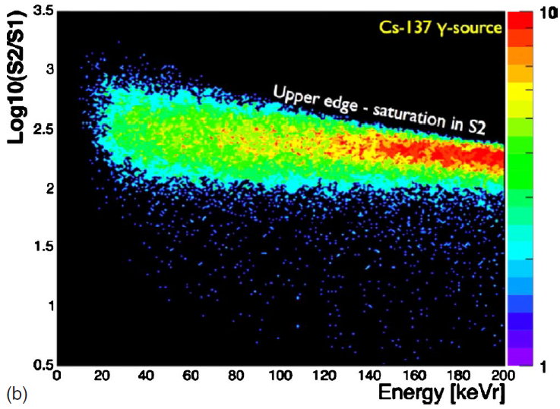
S1 / S2 separation in LXe
LUX experiment
XENON experiment
Notes:
If we use spectrum end point method we can reject background and gamma after radiative capture by spectra subtraction.
In Neutron double-scattering method we should realize another technique.
This technique is based on different ionization density for neutron and gamma, i.e. we will have different S2 S1 ratio.
Top and bottom left images represent logarithmic ratio of S2 and S1 as a function of energy and we can see clear separation between neutron elastic recoil and electron recoil used in XENON experiment
Right picture represent logarithmic ratio of S2 and S1 as a function of S1 used in LUX experiment.

Slide 27


Chamber 3D - view
Notes:
It is 3d model of our installation.
You can see the detector itself on the left picture and detector inside cryogenic chamber on the right picture.
A tube at the bottom of the right image is neutron generator.

Slide 28
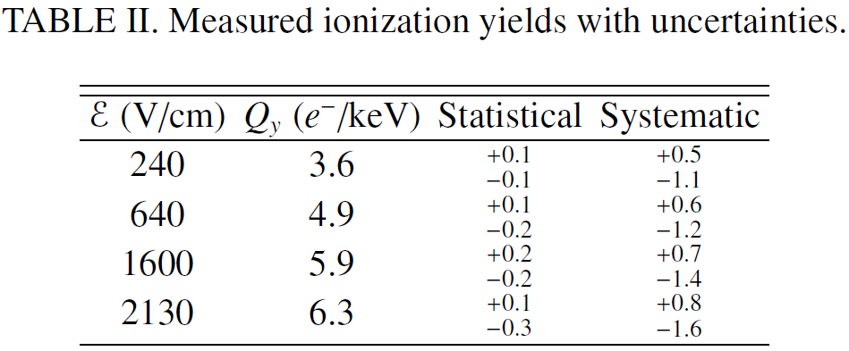
Ionization yield
SCENE experiment
Our previous results
EPL, 108 (2014) 12001
Phys. Rev. Lett., 112
(2014) 171303, 6.7 keVnr
Notes:
The experimental setup and its main parameters have been described and now we’ll discuss Measurement of ionization yield.
A particle interaction in the liquid phase produces primary scintillation (S1) and ionization .
The electrons are drifted away from the interaction site by an electric field and extracted into the gas where they create secondary scintillation (S2).
The ionization yield is ratio of number of electrons escaping recombination with positive ions (ne) and the energy deposited by a nuclear recoil (E).
While for liquid Xe there are ample experimental data on such yields, little is known about the ionization yield and scintillation efficiency in liquid Ar.
Recently the first results on the ionization yield of nuclear recoils in liquid argon have been presented in the low energy range: see the top right and the bottom right tables.
Also recently we have measured ionization yield at 80 and 233 keV.
In present work the ionization yield of nuclear recoils in liquid Ar has been measured at high energy 233 keV for several eclectic fields.
7:30 – 10:00

Slide 29
Ionization yield
Recently we have measured ionization yields of nuclear recoils in liquid argon at 80 and 233 keV (EPL, 108 (2014) 12001)
A particle interaction in the liquid phase produces primary scintillation (S1) and ionization.
The electrons are drifted away from the interaction site by an electric field and extracted into the gas where they create secondary scintillation (S2).
The ionization yield is ratio of number of electrons escaping recombination with positive ions (ne) and the energy deposited by a nuclear recoil (E).
In present work the ionization yield of nuclear recoils in liquid Ar has been measured at high energy 233 keV for several eclectic fields.
Notes:
The experimental setup and its main parameters have been described previously and now we’ll discuss Measurement of the ionization yield.
A particle interaction in the liquid phase produces primary scintillation (S1) and ionization .
The electrons are drifted away from the interaction site by an electric field and extracted into the gas where they create secondary scintillation (S2).
The ionization yield is ratio of number of electrons escaping recombination with positive ions (ne) and the energy deposited by a nuclear recoil (E).
While for liquid Xe there are ample experimental data on such yields, little is known about it in liquid Ar.
Recently we have measured ionization yield of nuclear recoils in liquid argon at 80 and 233 keV (see the picture).
In present work the ionization yield of nuclear recoils in liquid Ar has been measured at high energy 233 keV for several eclectic fields.
7:30 – 10:00

